Slide 1

Marta Live Map
I. Application Concept
II. Motivation
III. Design Process
Team Members
(alphabetical):
Daryl Bilderback
Limbert Bontigao
Gene Cannella
Thomas Gentle
Nic Nic
Tyler Maran

Slide 2
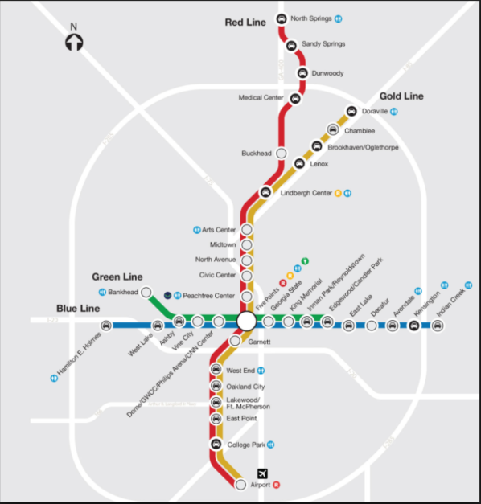
Marta Live Map
IV. DEMO
Team Members
(alphabetical):
Daryl Bilderback
Limbert Bontigao
Gene Cannella
Thomas Gentle
Nic Nic
Tyler Maran

Slide 3
Marta Live Map
V. Technologies Used
A. API’s :
developer.itsmarta.com
api.openweathermap.org
firebase.google.com
B. New Technologies or Libraries not discussed in Class:
AWS, AWS Lambda Function, Materialize, Modals, regex, Multi-Dimensional Arrays, DynamicURL Loading, etc.
Team Members
(alphabetical):
Daryl Bilderback
Limbert Bontigao
Gene Cannella
Thomas Gentle
Nic Nic
Tyler Maran

Slide 4
Marta Live Map
VI. Future Development:
* Better real-time movement graphics
* Monetize the App
Team Members
(alphabetical):
Daryl Bilderback
Limbert Bontigao
Gene Cannella
Thomas Gentle
Nic Nic
Tyler Maran

